Slide 1
YALTA CONFERENCE – ACTIVITY 2
Sources

Slide 2
Source 1
Source One: Stalin speaking to a fellow Communist Milovan Djilas, in 1945. Djilas was a supporter of Stalin.
“Perhaps you think that just because we are the allies of the English we have forgotten who they are and who Churchill is. There’s nothing they like better than to trick their allies. During the First World War they constantly tricked the Russians and the French. And Churchill? Churchill is the kind of man who will pick your pocket of a kopeck! (A kopeck is a low value Soviet coin). And Roosevelt? Roosevelt is not like that. He dips in his hand only for bigger coins. But Churchill? He will do it for a kopeck.”

Slide 3
Source 2
Source Two: Milovan Djilas writing about Yalta in 1948
“In the hallway (at Yalta) we stopped before a map of the world on which the Soviet Union was colored in red. Stalin waved his hand over the Soviet Union and exclaimed, “They (Roosevelt and Churchill) will never accept the idea that so great a space should be red, never, never!”

Slide 4
Source 3
Source Three: Written by Soviet Historian
“Once Churchill asked Stalin to send him the music of the new Soviet Russian anthem so that it could be broadcast before the summary of the news from the Soviet German front. Stalin sent the words (as well) and expressed hope that Churchill will set about learning the new tune and whistling it to members of the Conservative Party. While Stalin behaved with relative discretion with Roosevelt, he continually teased Churchill throughout the war.

Slide 5
Source 4
Source Four: Churchill writing to Roosevelt shortly after the Yalta Conference
“The Soviet Union has become a danger to the free world. A new front must be created against her onward sweep. This front should be Far East as possible. A settlement must be reached on all major issues between West and East in Europe before the armies of democracy melt.”

Slide 6
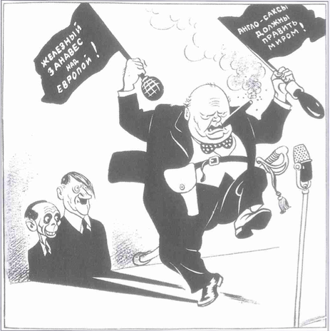
Source 5
Source Five: - A Soviet Cartoon. Churchill is shown with two flags, the first proclaiming that ‘Anglo-Saxons must rule the world’ and the other threatening an ‘Iron Curtain’.

Slide 7
Source 6
Source Six: - Written by Christopher Cuplin in a school textbook, The Modern World, 1984
“(At Yalta) Churchill feared that Roosevelt was too pro-Russian. He pressed for a French zone to be added to the other three to add another anti-Russian voice to the armies of occupation.”

Slide 8
Source 7
Source Seven: Milovan Djilas comments, in 1948 on Stalin’s assessment of Churchill
“One could see that Churchill had left a deep impression on the Soviet leaders as a farsighted and dangerous statesman – although they did not like him.”

Slide 9
Source 8
Source Eight: Written by historian Hugh Higgins in The Cold War, 1974
“(In May 1945) Churchill ordered Montgomery to keep the German arms intact, in case they had to be used against the Russians.”

Slide 10
Source 9
Source 9: The Soviet Foreign Minister Molotov writing about Yalta.
“One night Stalin stung Churchill when proposing a toast by reminding of his failures at Gallipoli in the First World War.
“Another night Churchill declared (whilst slightly drunk) that he deserved a medal for teaching the Soviet army to fight so well through the intervention at Archangel.”

